Slide 1
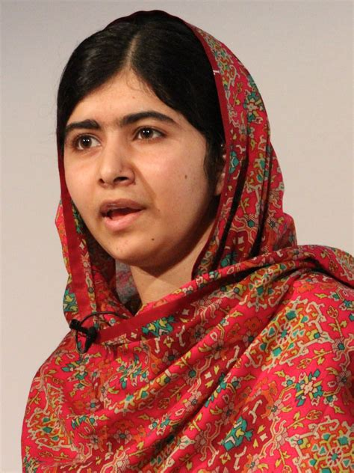
March Is Women’s History Month Weekly Spotlight: International Women’s Day – 3/8/22
This year’s theme is: “Gender equality today for a sustainable tomorrow”, recognizing the contribution of women and girls around the world, who are leading the charge on climate change adaptation, mitigation to build a more sustainable future for all. unwomen.org
“No struggle can ever succeed without women participating side by side with men. There are two powers in the world; one is the sword and the other is the pen. There is a third power stronger than both, that of women.” - Malala Yousafzai

